Slide 1
Economics 144 Economic Forecasting
Lecture 9
Characterizing Cycles
ARMA Models
Dr. Randall R. Rojas

Slide 2
Today’s Class
Review of the MA(q) Process
Review of the AR(p) Process
Seasonal AR(p) Model: S-AR(p)
Seasonal MA(q) Model: S-MA(q)
Rational Distributed Lags
Autoregressive Moving Average (ARMA) Models
R Example

Slide 3
Moving Average (MA) Models
Moving-average (MA) models are always weakly stationary because they are finite linear combinations of a white noise sequence for which the first two moments are time invariant.
Moving average processes are useful in describing phenomena in which events produce an immediate effect that only lasts for short periods of time.
The MA model is a simple extension of the white noise series.

Slide 4





Moving Average (MA) Models The MA(1) Process 1 of 4
The first-order moving average process, MA(1) is:
Unconditional mean and variance are:
Conditional mean and variance are:
and
and
One-period memory of the MA(1) process.

Slide 5
Moving Average (MA) Models The MA(1) Process 2 of 4
The autocovariance function for the MA(1) process is:
The autocorrelation function for the MA(1) process is:
θσ², τ =1
0, otherwise
γ(τ) =
θ/(1+θ²), τ =1
0, otherwise
ρ(τ) =
Sharp cutoff beyond displacement 1.

Slide 6




Moving Average (MA) Models The MA(1) Process 3 of 4
Invertible MA(1) process: If |θ| < 1, then can ‘invert’ the MA(1) process. The inverted series is referred to as an autoregressive representation.
Example: Autoregressive representation of the MA(1) process. and
Solve for ε_{t} →
•••

Slide 7

Moving Average (MA) Models The MA(1) Process 4 of 4
After backward substitution:
In lag operator notation:
The lag operator polynomial has one root, which is obtained by solving for L from:
→L =-1/θ
Note: The inverse will be less than 1 in absolute value if |θ|<1.
autoregressive
representation

Slide 8


Moving Average (MA) Models The MA(q) Process
Consider the finite-order moving average process of order q, MA(q):
where
The higher order terms in the MA(q) process can capture more complex dynamic patterns.
The MA(q) process is invertible provided the inverses of all of the roots are inside the unit circle.
autoregressive
representation
The MA(q) approximates an infinite
moving average with a finite-order
moving average.

Slide 9
Autoregressive (AR) Models
Autoregressive Models (AR) models are always invertible. However, to be stationary, the roots of Φ (L)y_{t}=ε_{t} must lie outside the unit circle.
Autoregressive processes are useful in describing situations in which the present value of a time series depends on its preceding values plus a random shock.
AR processes are stochastic difference equations. They are used for modeling discrete-time stochastic dynamic processes (among others).

Slide 10



Autoregressive (AR) Models The AR(1) Process 1 of 3
The first-order autoregressive process, AR(1) is:
Unconditional mean and variance are:
Conditional mean and variance are:
and
and

Slide 11
Autoregressive (AR) Models The AR(1) Process 2 of 3
Yule-Walker Equation: γ(τ) = φ γ(τ-1) (recursive relation)
The autocovariance function for the AR(1) process is:
The autocorrelation function for the AR(1) process is:
The partial autocorrelation function for the AR(1) process is:
1-φ²
γ(τ) =φ^{τ} , τ = 0, 1, 2, …
σ²
ρ(τ) =φ^{τ}, τ = 0, 1, 2, …
φ, τ =0
0, τ > 1
p(τ) =
Notes:
Yule-W eqn says we can apply the recursion on the autocorrelation

Slide 12

Autoregressive (AR) Models The AR(1) Process 3 of 3
After backward substitution:
In lag operator notation:
The moving average representation for y is convergent if and only if |φ|<1 (covariance stationary condition for the AR(1) process).

Slide 13

Autoregressive (AR) Models The AR(p) Process
The general pth order autoregressive process, AR(p) is:
In lag operator form:
The AR(p) process is covariance stationary if and only if the inverses of all roots of Φ(L) are inside the unit circle (Σφ<1).
convergent infinite moving average

Slide 14
Seasonal Autoregressive Models: S-AR(p)
Deterministic Seasonal Cycle

Slide 15
Seasonal Autoregressive Models: S-AR(p)
Stochastic Seasonal Cycle
We will examine these cases for this class.

Slide 16
Seasonal Autoregressive Models: S-AR(p)
S-AR Model: Y_{t} = c +ϕ_{s} Y_{t-s} + ε_{t}, where s = frequency.
Convention:
quarterly→ s = 4
monthly→ s = 12
daily → s = 7 or s = 5 (weekdays only)
Example: S-AR(1) with s=4 (quarterly data)
Y_{t} = c +ϕ₄ Y_{t-4} + ε_{t}

Slide 17
Seasonal Autoregressive Models: S-AR(p)
Def: S-AR(p) Model = Seasonal AR model of order p.
Y_{t} = c +ϕ_{1s} Y_{t-1s} + ϕ_{2s} Y_{t-2s} +…+ ϕ_{ps} Y_{t-ps} + ε_{t}
We can also express the S-AR(p) model in lag-operator form as:
(1-ϕ_{1s}L^{s} + ϕ_{2s} L^{2s} +…+ ϕ_{ps} L^{ps} ) Y_{t} = c+ε_{t}
p=order
s=frequency

Slide 18
Seasonal Autoregressive Models: S-AR(p)
Example 1: Identify the correct S-AR(p) model for the process: Y_{t} = c +ϕ₄ Y_{t-4}+ ε_{t}
Example 2: Identify the correct S-AR(p) model for the process: Y_{t} = c +ϕ₁₂ Y_{t-12}+ ε_{t}
We can express it as: Y_{t} = c +ϕ_{1×4} Y_{t-1×4}+ ε_{t}→ p=1, s=4
→S-AR(1) with s=4 (Quarterly)
We can express it as: Y_{t} = c +ϕ_{1×12} Y_{t-1×12}+ ε_{t}→ p=1, s=12
→S-AR(1) with s=12 (Monthly)

Slide 19
Seasonal Autoregressive Models: S-AR(p)
Example 3: Identify the correct S-AR(p) model for the process: Y_{t} = c +ϕ₄ Y_{t-4}+ϕ₈ Y_{t-8} + ε_{t}
Example 4: Identify the correct S-AR(p) model for the process: Y_{t} = c +ϕ₁₂ Y_{t-12}++ϕ₂₄ Y_{t-24} + ε_{t}
We can express it as: Y_{t} = c +ϕ_{1×4} Y_{t-1×4}+ϕ_{2×4} Y_{t-2×4}+ ε_{t}
→ p=2, s=4
→S-AR(2) with s=4 (Quarterly)
We can express it as: Y_{t} = c +ϕ_{1×12} Y_{t-1×12}+ϕ_{2×12} Y_{t-2×12}+ ε_{t}
→ p=2, s=12
→S-AR(2) with s=12 (Monthly)

Slide 20
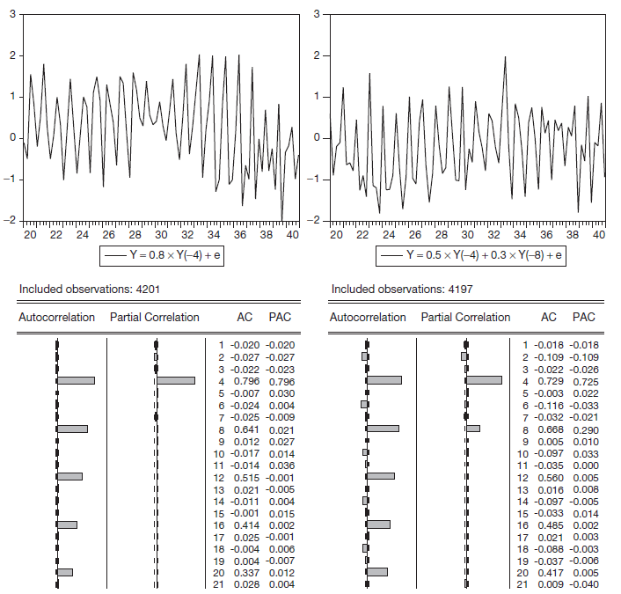
Seasonal AR(1)
4
8
12
16
ACF: spikes at 1s, 2s,…
Then decays to zero.
PACF: 1-spike→AR(1)
Lag =4→ s=4(quarterly)
Notes:
For s-ar, we detect the order from the PACF and the seasonality from ACF

Slide 21
Seasonal AR(2)
4
8
12
16
ACF: spikes at 1s, 2s,…
Then decays to zero.
PACF: 2-spikes→AR(2)
Lag =4→ s=4(quarterly)

Slide 22
Seasonal AR(2) Example: Monthly Clothing Sales
Q: What model would you suggest?
→S-AR(1) with s=12
Notes:
The difference between the seasonal and not seasonal AR is that the ACF decays at s frequency for seasonal and ACF decays at frequency 1 for not seasonal

Slide 23
Seasonal Autoregressive Models: S-MA(q)
Def: S-MA(q) Model = Seasonal MA model of order q.
Y_{t} = μ +θ_{1s} ε_{t-1s} + θ_{2s} ε_{t-2s} +…+ θ_{qs} ε_{t-qs} + ε_{t}
We can also express the S-MA(q) model in lag-operator form as:
Y_{t} =μ+(1+θ_{1s}L^{s} + θ_{2s} L^{2s} +…+ θ_{qs} L^{qs} )ε_{t}
p=order
s=frequency

Slide 24
Seasonal Autoregressive Models: S-MA(q)
Example 1: Identify the correct S-MA(q) model for the process: Y_{t} = μ +θ₄ ε_{t-4} + ε_{t}
Example 2: Identify the correct S-MA(q) model for the process: Y_{t} = μ +θ₁₂ ε_{t-12} + ε_{t}
We can express it as: Y_{t} = μ +θ_{1×4} ε_{t-1×4}+ ε_{t}→ q=1, s=4
→S-MA(1) with s=4 (Quarterly)
We can express it as: Y_{t} = μ +θ_{1×12} ε_{t-1×12}+ ε_{t}→ q=1, s=12
→S-MA(1) with s=12 (Monthly)

Slide 25
Seasonal Autoregressive Models: S-MA(q)
Example 1: Identify the correct S-MA(q) model for the process: Y_{t} = μ +θ₄ ε_{t-4} + θ₈ ε_{t-8} + ε_{t}
Example 2: Identify the correct S-MA(q) model for the process: Y_{t} = μ +θ₁₂ ε_{t-12} + θ₂₄ ε_{t-24} + ε_{t}
We can express it as: Y_{t} = μ +θ_{2×4} ε_{t-2×4}+ ε_{t}→ q=2, s=4
→S-MA(2) with s=4 (Quarterly)
We can express it as: Y_{t} = μ +θ_{2×12} ε_{t-2×12}+ ε_{t}→ q=2, s=12
→S-MA(2) with s=12 (Monthly)

Slide 26
Seasonal MA(1)
4
8
12
16
ACF: 1-spike→MA(1)
Lag =4→ s=4(quarterly)
PACF: spikes at 1s, 2s,…
Then decays to zero.
Notes:
For S-MA, the order is at the ACF and the seasonality is seen at the PACF

Slide 27
Seasonal MA(2)
4
8
12
16
ACF: 2-spikes→MA(2)
Lag =4→ s=4(quarterly)
PACF: spikes at 1s, 2s,…
Then decays to zero.

Slide 28
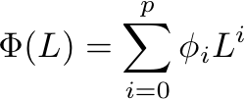
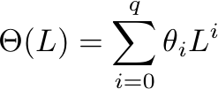

Rational Distributed Lags
Rational Distributed Lags:
polynomial of
degree q
polynomial of
degree p
(In practice use an approximation)
Rational distributed lags produce models of cycles that
economize on parameters.
If p and q are small (e.g., 0, 1, or 2), then estimation of B(L) is easy.
Notes:
The data has to be covariance stationary (for the MA) and invertible(For both MA and AR)

Slide 29



Autoregressive Moving Average (ARMA) Models→ARMA(p,q)
Recall from Wold’s approximation that:
and
ARMA Models are often highly
accurate and highly parsimonious.
AR(p)
MA(q)
The ARMA model combines the ideas of AR and MA models
into a compact form so that the number of parameters used is
kept small, achieving parsimony in parameterization.

Slide 30


Autoregressive Moving Average (ARMA) Models→ARMA(p,q) 1 of 2
The ARMA(1,1) Process: Y_{t} = ϕY_{t-1}+θε_{t-1}+ε_{t}
In lag operator form: (1-ϕL)Y_{t} = (1+θL) ε_{t}
where |ϕ| <1 for stationarity and |θ| <1 for invertibility.
(if stationary)
(if invertible)

Slide 31



Autoregressive Moving Average (ARMA) Models→ARMA(p,q) 2 of 2
The ARMA(p,q) Process:
→
where
and
(if stationary)
(if invertible)

Slide 32
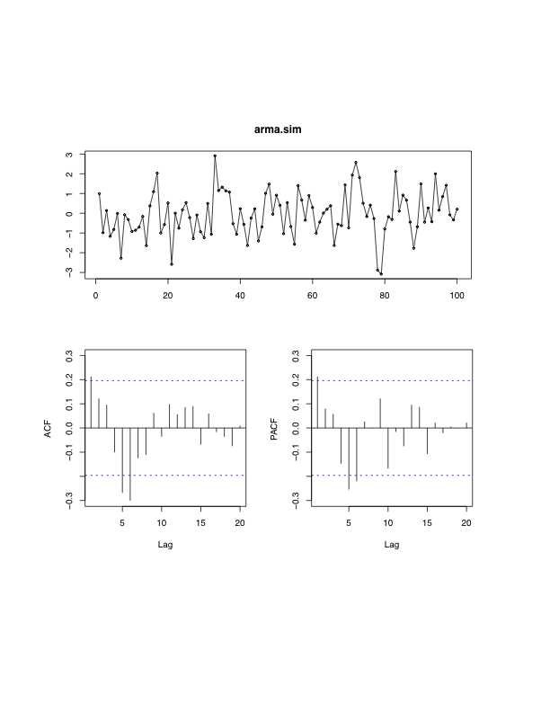
Mystery Process ☺
ARMA(2,2)
MA(2)
AR(2)

Slide 33
Summary 1 of 3
AR(p): Current value of Y_{t} can be found from past values, plus a random shock ε_{t}.
Y_{t} is regressed on past values of Y_{t}.
MA(q): Current value of Y_{t} can be found from past shocks, plus a new shock/error ε_{t}.
The time series is regarded as a moving average (unevenly weighted, because of different coefficients) of a random shock series ε_{t}.

Slide 34
Summary 2 of 3
For MA models, ACF is useful in specifying the order because ACF cuts off at lag q for an MA(q) series.
For AR models, PACF is useful in order determination because PACF cuts off at lag p for an AR(p) process.
For an ARMA(p,q) process, lower-order models are better. For example, ARMA(1,1) is better than AR(3).

Slide 35


Summary 3 of 3
Full Model: Y_{t} = T + S +C
Trend:
Seasonal:
Cycle:

Slide 36
For Next Class
Readings about today’s class:
Chapter 7ª, 8^{b}
Review Exercises / Problems:
Chapter 8^{b}: 2, 3, 4, 9
Readings for next class:
Chapter 8ª, 9^{b}

